Slide 1
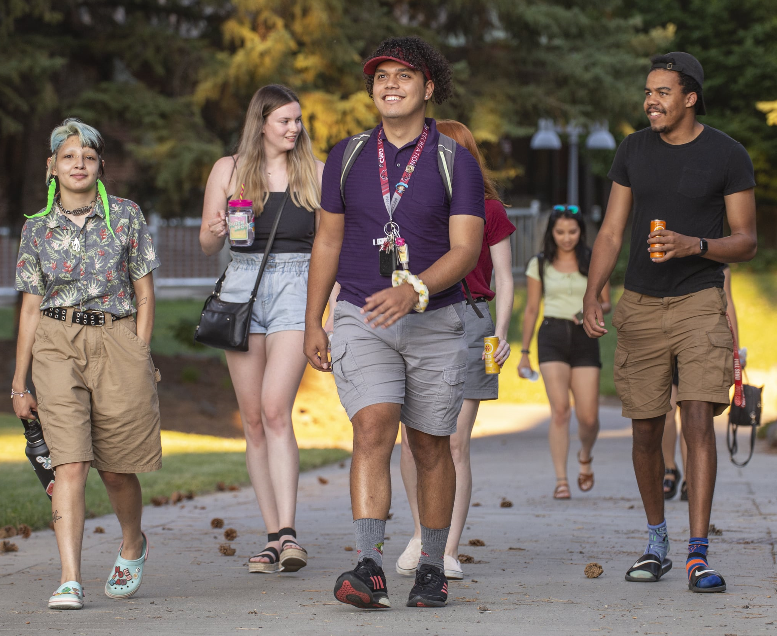
State of the University
President Jim Wohlpart
September 29, 2023

Slide 2


The Bear

Slide 3

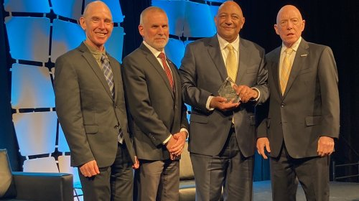
Wildcats Do Great Things
CWU’s Andy Parks Earns Prestigious Lifetime Achievement Award for Diversity Impact
CWU Students Win the 2023 IEN Corporate Engagement Challenge

Slide 4
Three Takeaways
What you do matters.
2. We are becoming a vision, mission and values aligned university.
3. We have overcome some head winds, and have more to face, but we have a bright future ahead of us.

Slide 5
Why are we here?

Slide 6
Vision Statement
Central Washington University will be a model learning community of equity and belonging.
Approved by the CWU Board of Trustees, May 20, 2022

Slide 7
Mission Statement
In order to build a community of equity and belonging, Central Washington University nurtures culturally sustaining practices that expand access and success to all students. We are committed to fostering high impact practices, sustainability, and authentic community partnerships that are grounded in meaningful relationships.
Approved by the CWU Board of Trustees, May 20, 2022

Slide 8
Unifying Value: Student Success
Central Washington University creates pathways for students of all backgrounds to reach their academic and professional goals. Through providing a supportive learning environment, faculty and staff inspire students to become engaged professionals, active citizens, and lifelong learners.
Approved by the CWU Board of Trustees, July 21, 2023

Slide 9
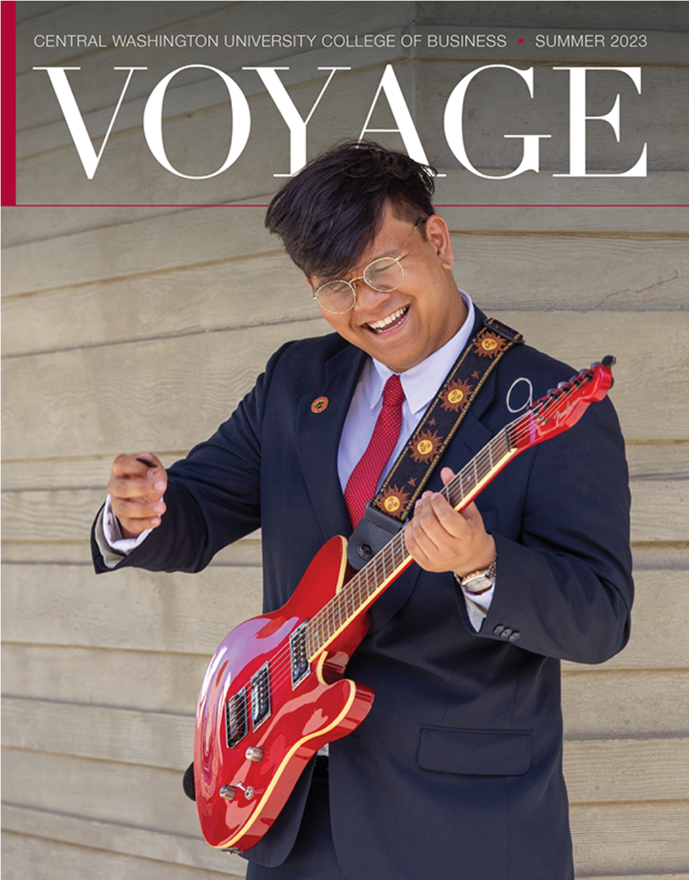
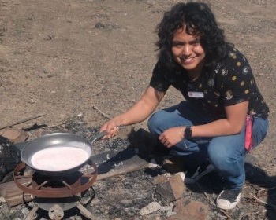
Wildcats Do Great Things
CWU Senior Nick Puentes Receives Competitive NSF Fellowship
CWU Accounting graduate Matthew Braganza headed to Cornell University

Slide 10
What do we do?

Slide 11
Mission Statement
In order to build a community of equity and belonging, Central Washington University nurtures culturally sustaining practices that expand access and success to all students. We are committed to fostering high impact practices, sustainability, and authentic community partnerships that are grounded in meaningful relationships.
Approved by the CWU Board of Trustees, May 20, 2022

Slide 12
Unifying Value: Student Success
Central Washington University creates pathways for students of all backgrounds to reach their academic and professional goals. Through providing a supportive learning environment, faculty and staff inspire students to become engaged professionals, active citizens, and lifelong learners.
Approved by the CWU Board of Trustees, July 21, 2023

Slide 13
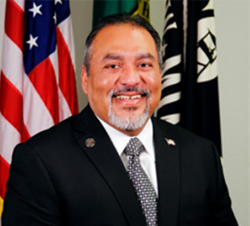
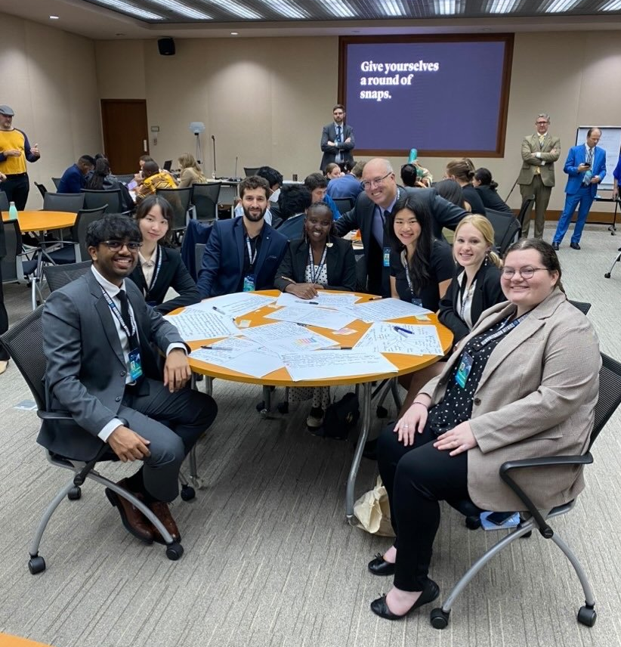
Wildcats Do Great Things
David Puente, Jr. (B.S., Occupational Safety) appointed Director, Washington State Department of Veterans Affairs
CWU Student Emma CrowE (far right) represents CWU at the United Nations Green Summit

Slide 14
How will we do it?

Slide 15
Vision, Mission, & Values-based University
Strategic Plan
Vision
Mission
Values
Budget
Performance Management
Enrollment Management
Comprehensive Campaign

Slide 16
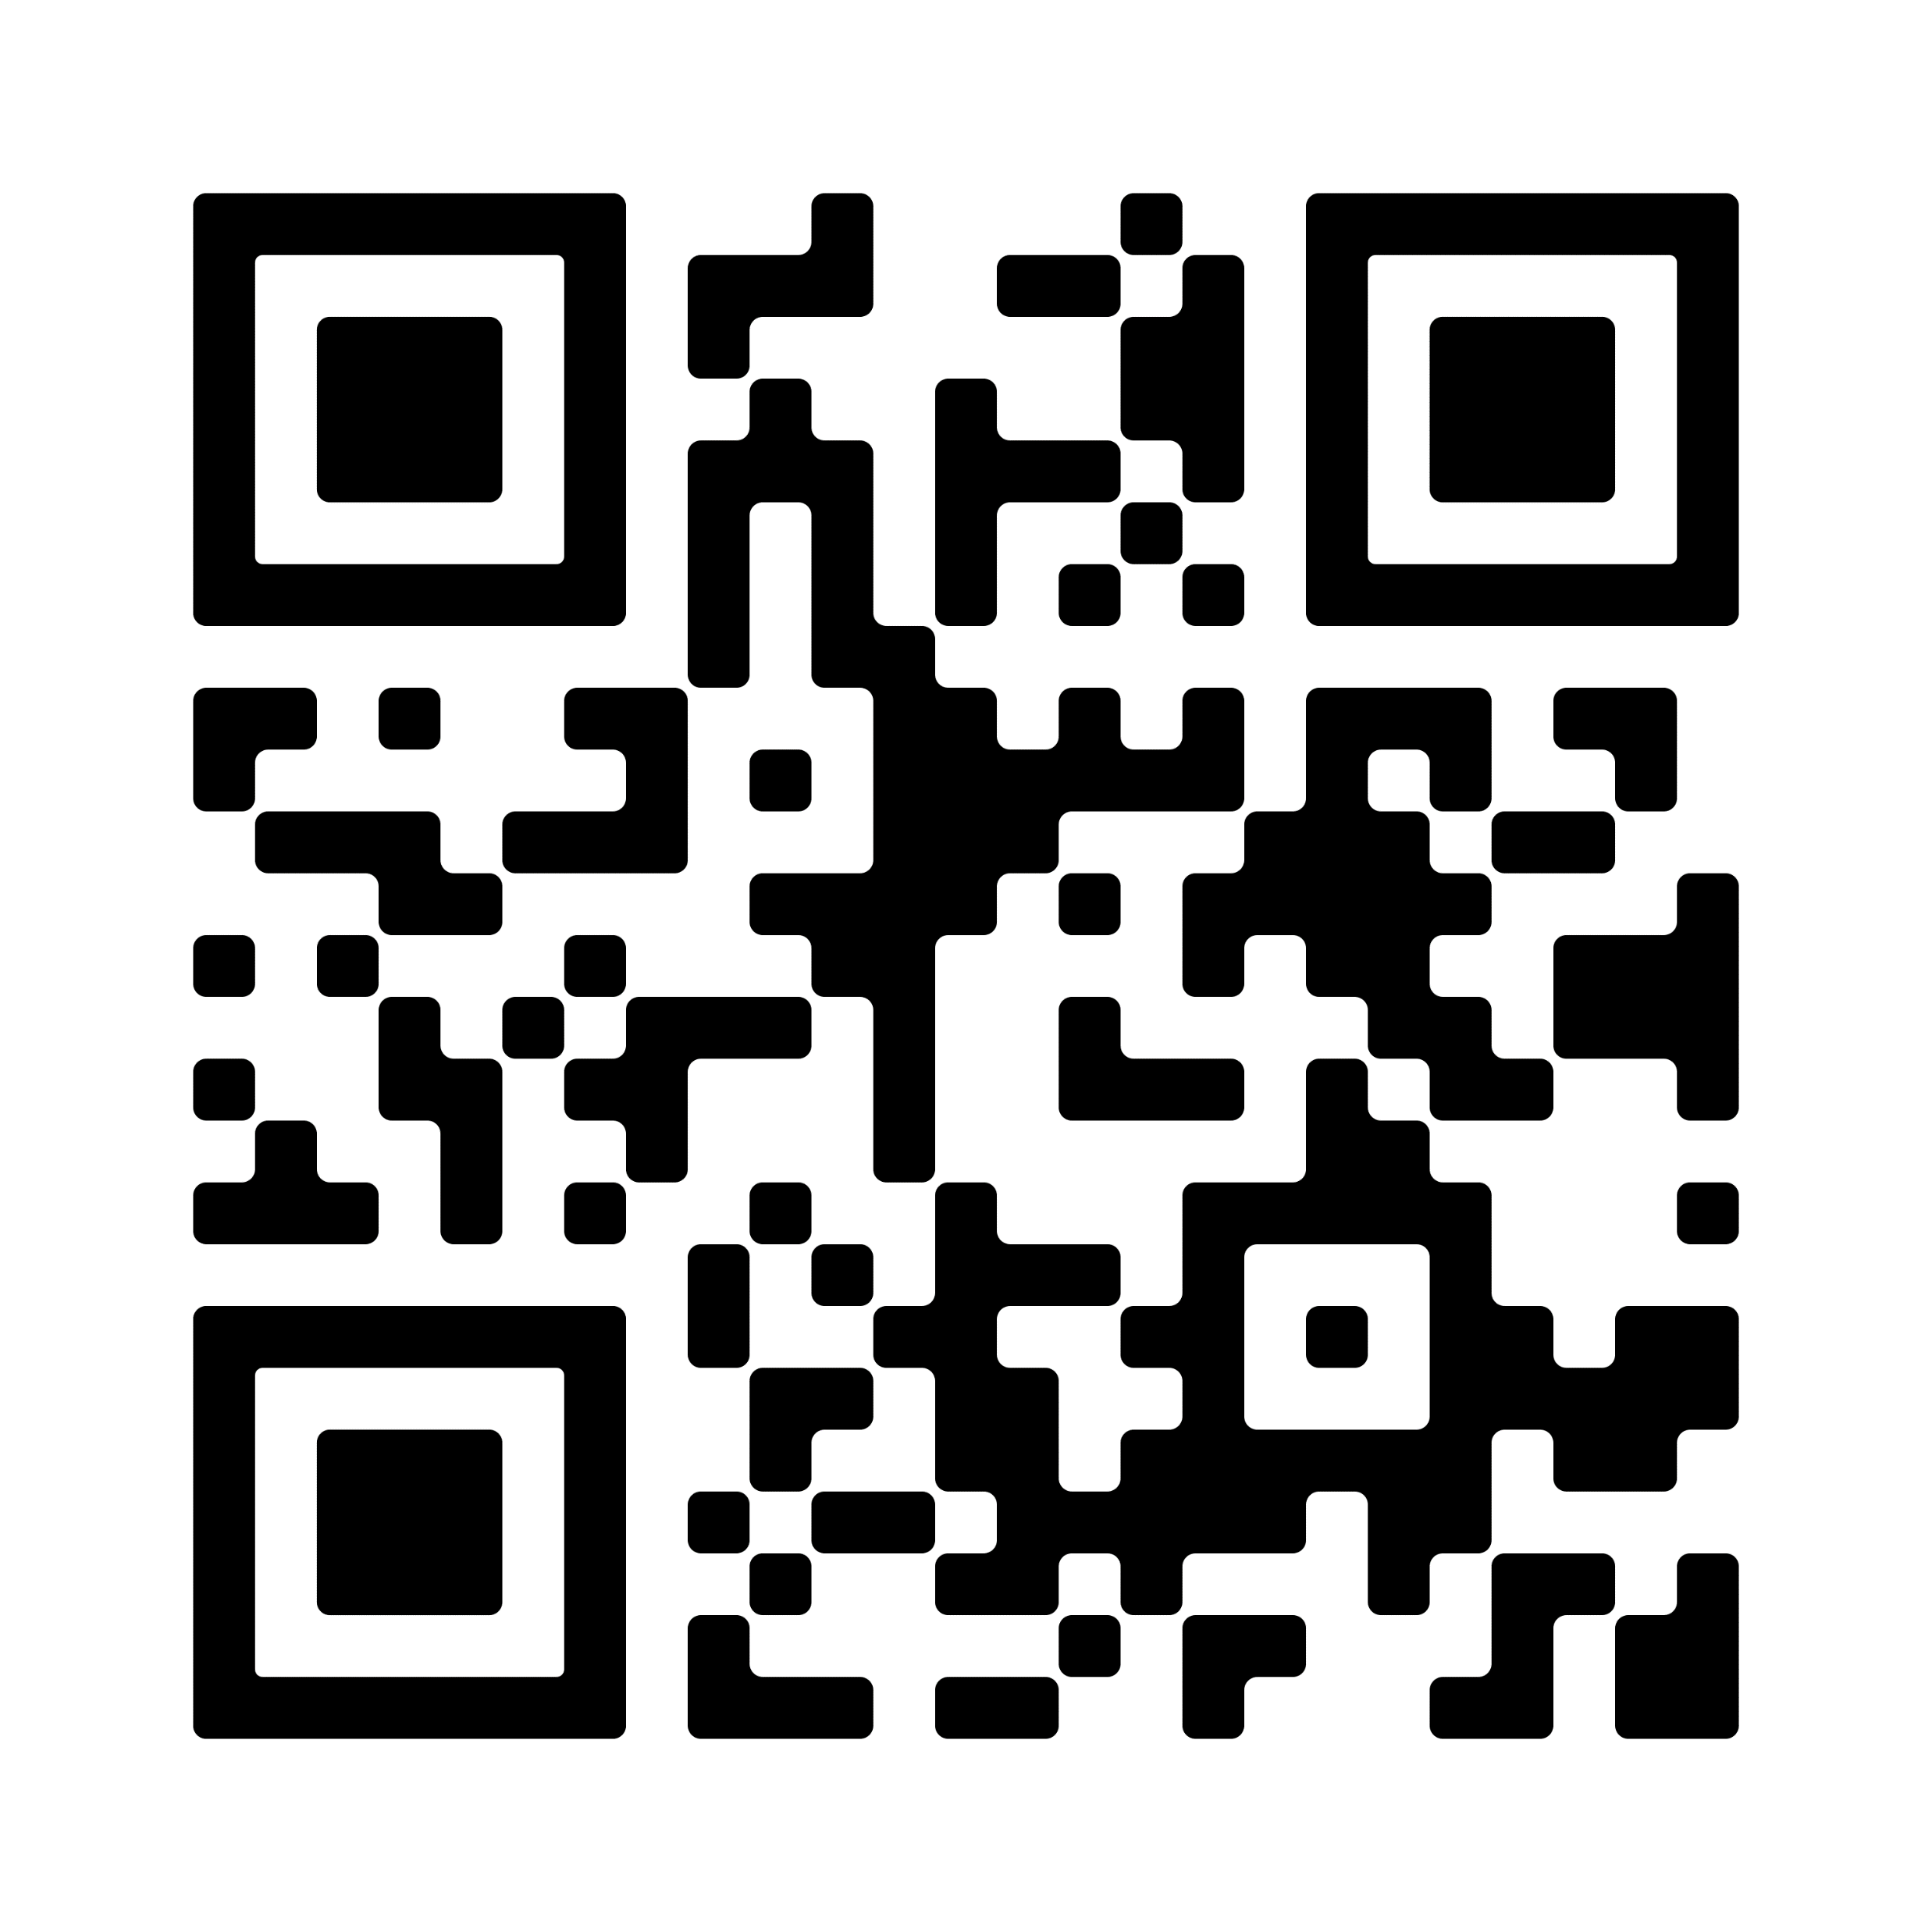
Values-based Strategic Plan

Slide 17
Values-based Strategic Plan
“Culture eats strategy for breakfast.”
Peter Drucker

Slide 18
Values-based Budget
Core Value: Stewardship
Goal 3: Implement values-based budgeting
Four Principles
Cover instructional expenses to meet teaching needs and meet the goals of the strategic plan.
Invest in non-instructional expenses to meet the goals of the strategic plan.
Provide sufficient goods & services budget to meet the needs of the university.
Create a Values Based Fund to invest in the strategic plan.

Slide 19
State General Fund Actuals

Slide 20
FY24 State & Local Budget (Preliminary)
(in ‘000’s)
Budget Assumptions
1,800 new freshman
9,300 total students
200 student contingency
2,315 occupancy

Slide 21
FY24 “System” Budget (Preliminary)
(in ‘000’s)
Budget Assumptions
1,800 new freshman
9,300 total students
200 student contingency
2,315 occupancy

Slide 22


New Funding Streams
Regional Tech and Innovation Hub
Horizons and Limitless Grants

Slide 23
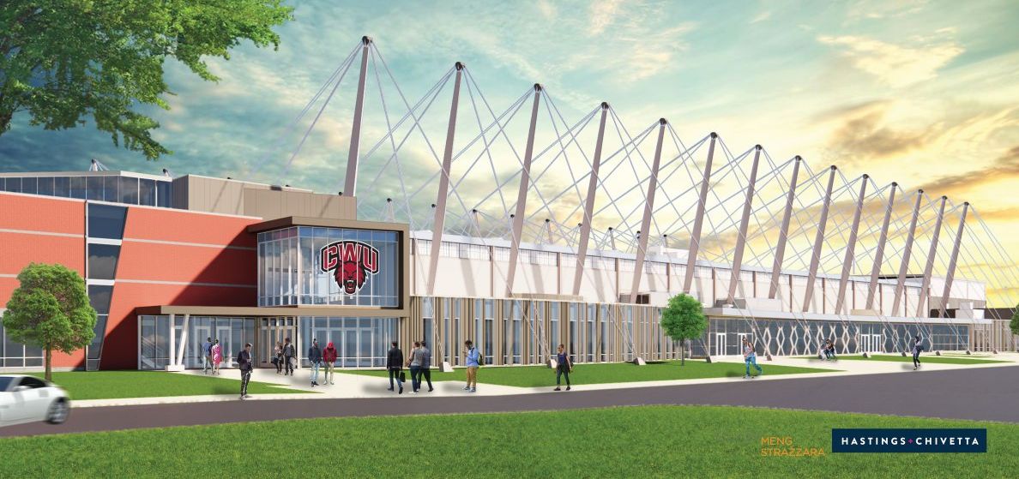
Capital Projects
Health Education / Nicholson Pavilion ($63M)
North Academic Complex ($103M)
Multicultural Complex ($6M)
Arts Complex (Pre-Design $300K)

Slide 24
Supplemental Budget – FY24
Operating Requests
Student Basic Needs Package
  Food Pantry Coordinator and Interns – $126K
  Violence prevention coordinator – $154K
  Financial literacy coaches – $117K
College in the High School Instructor Training and Summer Institute

Slide 25
Supplemental Budget – FY24
Capital Requests
Secondary Geothermal Well– $16.5M*
Science Building Carbon Reduction – $4.5M*
Emergency Back-up Power System – $4.3M
*Climate Commitment Act Incentive

Slide 26
Values-based Performance Management
Core Value 3: Nurture internal talent
Goal: Create a whole-person, human-centered learning organization that advances the vision and mission of the university through a values-based performance management system.
Principles
Elevate purposeful and meaningful, right-sized work
Expand professional development, mentoring and coaching opportunities (emotional intelligence, vocational discernment, adaptive leadership)
Elevate leadership development to nurture leaders-in-place
Advance a culture of belonging
Develop an abundance mindset

Slide 27
Values-based Performance Management
Core Value 2: Belonging
Initiative 1.3 Equity in faculty criteria for promotion and tenure.
All Faculty Town Hall: Establishing Equity
in the Faculty Evaluation Process
  Tuesday, October 3, 2:00-4:00, Ballroom
  All Faculty, Deans, Provost, AVPs, etc.
  Dr. Kris De Welde, College of Charleston
Tenure, Tenure-Track Faculty Convenings I and II
  Dates, times, and registration forthcoming
Non-Tenure Track Faculty Convening
  Dates, times, and registration forthcoming

Slide 28
Values-based Performance Management
Core Value 2: Belonging
Initiative 3.1: Diversity, equity, and inclusion (DEI) professional development programs.
Tier One
Required for all new (and continuing) employees
DEI for the Workplace (Get Inclusive) – online training
Four modules
  Foundations
  Inclusive Hiring
  Microaggressions in the Workplace
  Unconscious Bias in the Workplace
Tier Two
Extended sessions to deepen knowledge and commitment
Sessions include
  New Faculty Orientation
  Equity in Faculty Evaluation
  Anti-racist Culturally Responsive Teaching
  Living Social Justice
  Leadership for Collaborative Practice
  Anti-racist Emotional Intelligence

Slide 29
Values-based Enrollment Management
Unifying Value: Student Success
Goal 1: Develop clear pathways into and through the university
Core Value: Belonging
Goal 2: Become a Hispanic Serving Institution
Increase new freshman and transfer student enrollment and retention.
Develop clear pathways into and through the university:
  Increase College in the High School participation.
  Revise pedagogy and curriculum to take down barriers to success.
Become a Hispanic Serving Institution.
Use data to inform recruitment and retention practices to be intentional and strategic about growing our enrollment.
Integrate our marketing and branding with our recruitment.

Slide 30
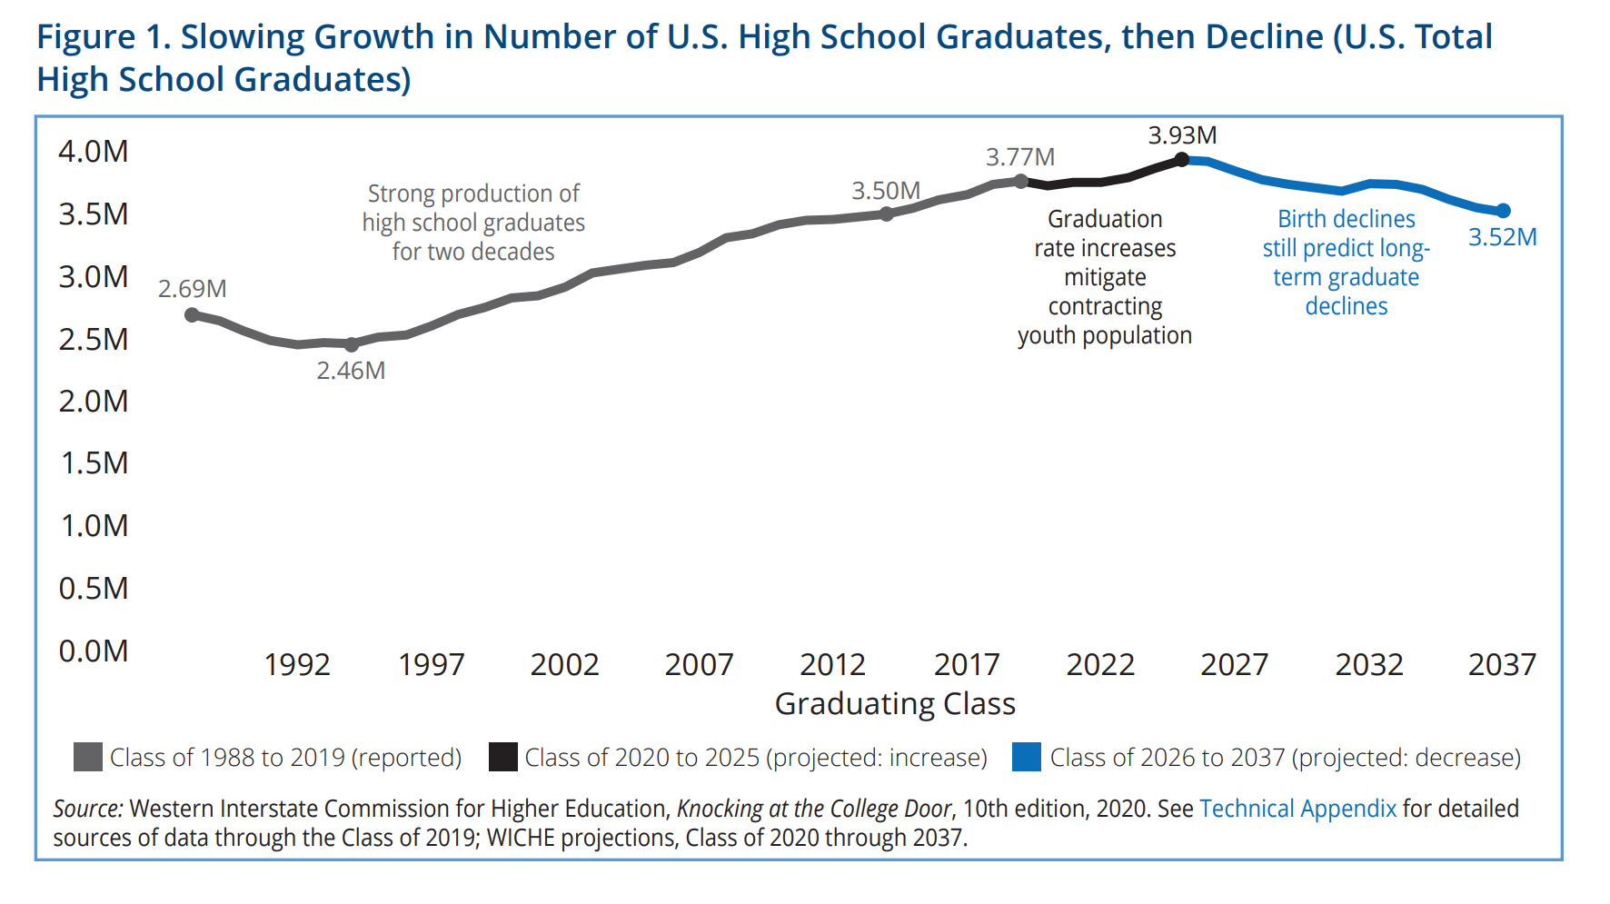
U.S. High School Graduates

Slide 31




CWU Fall Quarter Enrollment
CWU Enrollment History – 70 years
14,000
12,000
10,000
8,000
6,000
4,000
2,000
0
2019
2004
Head Count
1970

Slide 32
Fall 2019 – Fall 2022 Total Enrollment (Actual)

Slide 33
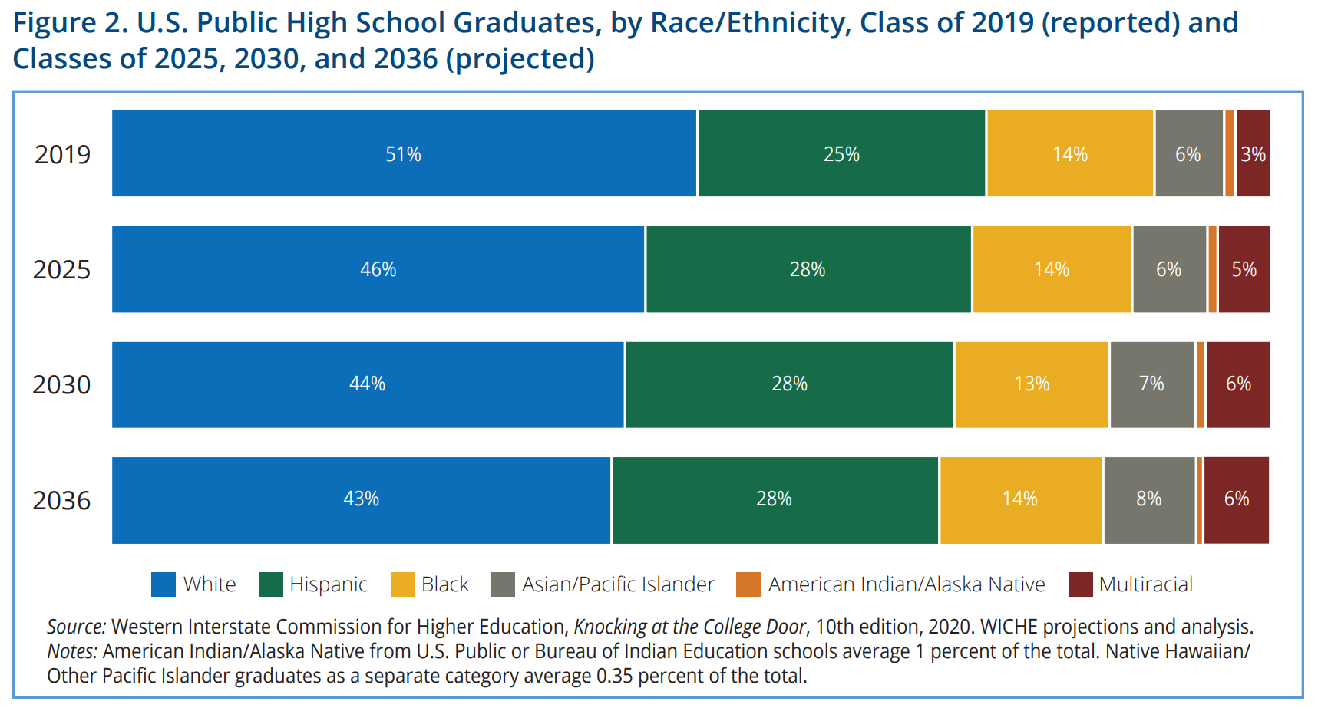
U.S. High School Graduates – Race/Ethnicity

Slide 34
Values-based Enrollment Management
Brand Messaging Platform
We See Futures
New Marketing Tagline
Create Your Future

Slide 35
Fall ’23 Admissions Funnel

Slide 36
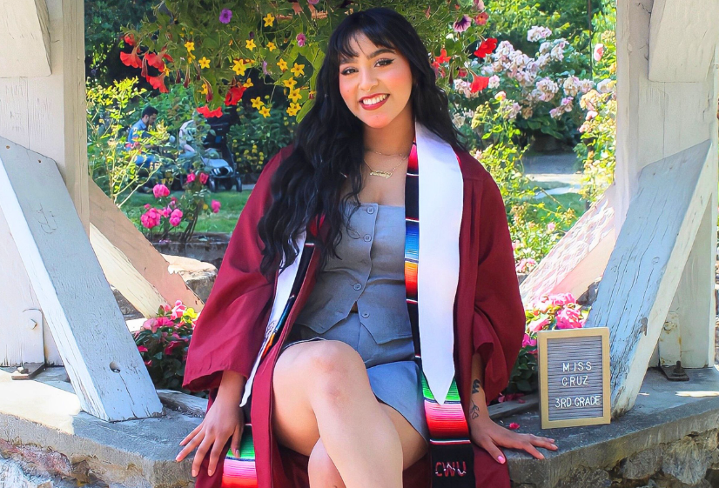

Wildcats Do Great Things
CWU School of Education graduate Litzy Cruz will begin her career this fall as a dual-language third-grade teacher in Puyallup
CWU Wildcats are Three-Time GNAC Academic
All-Sport Award Recipients

Slide 37
Values-based Comprehensive Campaign
Core Value: Engagement, Initiative 2.3
Mission
Vision
Values
Brand Messaging
Brand Rollout
Comprehensive Campaign
Strategic Planning
New Tagline
New Website
Internal External Ext

Slide 38

Our Campaign for Central Washington University

Slide 39
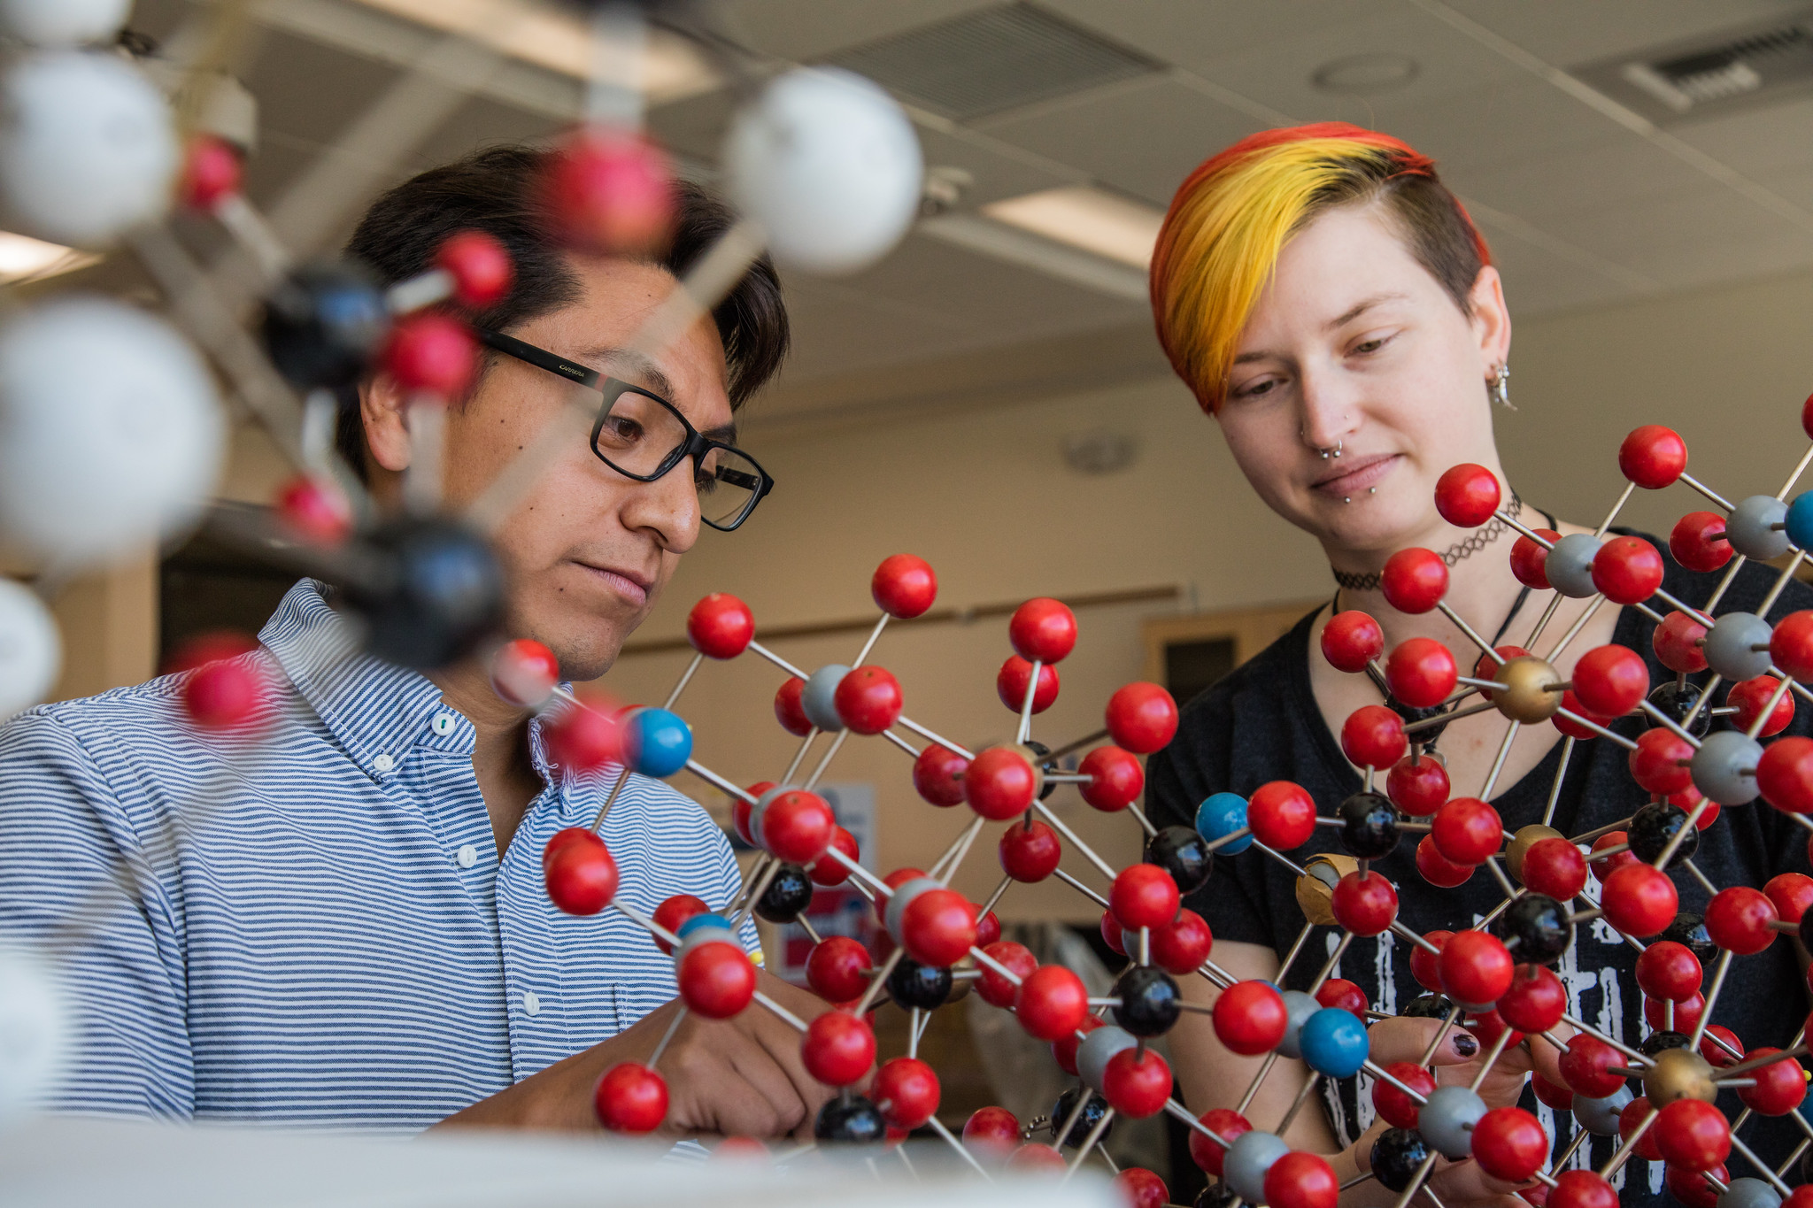

Futures \ Opportunity
  Key Investments
We will throw open the doors to a life-changing education for every aspiring Wildcat who’s ready to take on their future here.
  Wildcat Promise
  Scholarships
  Basic Needs
  Affordable learning materials

Slide 40
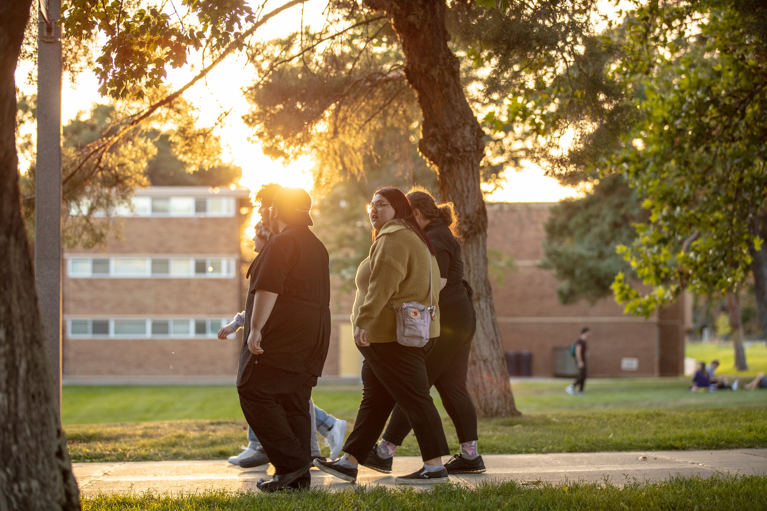

Futures \ Experience
  Key Investments
  Undergraduate Research
  Study Away
  Real-World Practice
  Institute of Civic and
  Community Engagement
  Center for Engaged Learning
We will make sure every student who chooses Central gets the best of Central.

Slide 41


Futures \ Impact
  Key Investments
  Center for Financial Planning and Well-Being
  Center for Excellence in Science and Math Education
  Health Sciences
  Humanities of the Future
  Tomlinson Stadium
We will build the future of education at Central Washington University and define the career paths of tomorrow.

Slide 42
Recent Philanthropic Support

Slide 43
Total philanthropic support
 | Total Commitments | Cash/Revenue | Donors | Alumni Donors
FY23 | $9,306,082 | $3,461,210 | 3,247 | 1,481
FY22 | $8,553,100 | $4,568,708 | 2,858 | 1,694
FY21 | $8,110,304 | $3,483,210 | 3,318 | 1,990

Slide 44
Units Supported
 | General Scholarships/ Other | Athletics | CAH | CB | CEPS | COTS | Students First Fund | Programs | Wildcat Promise
FY23 | 1.9M | 1.9M | 2.6M | 600k | 269k | 1.5M | 106k | 206k | 300k
FY22 | 3.6M | 1.3M | 736k | 335k | 672k | 1.5M | 111k | 108k | -

Slide 45
Endowment Growth

Slide 46
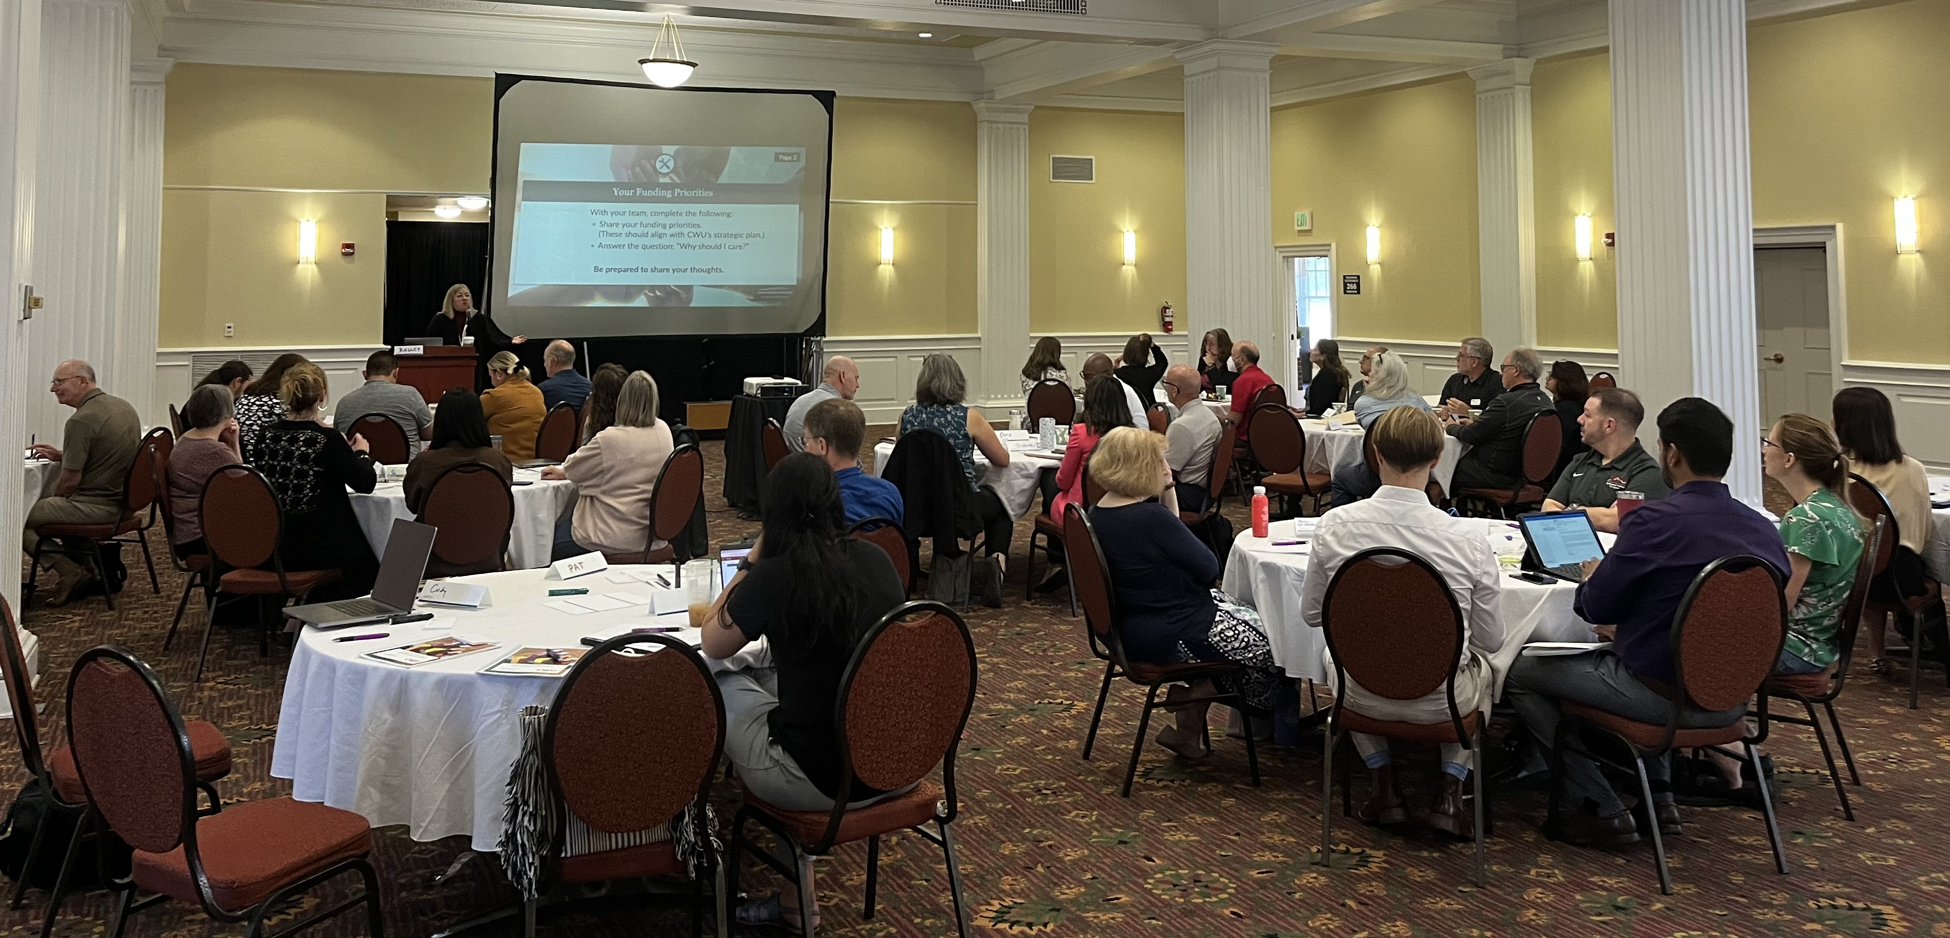

Comprehensive Campaign Retreat
Retreat with Deans, Development Officers, Department Chairs, and Advancement Staff on Thursday, September 14, 2023.

Slide 47
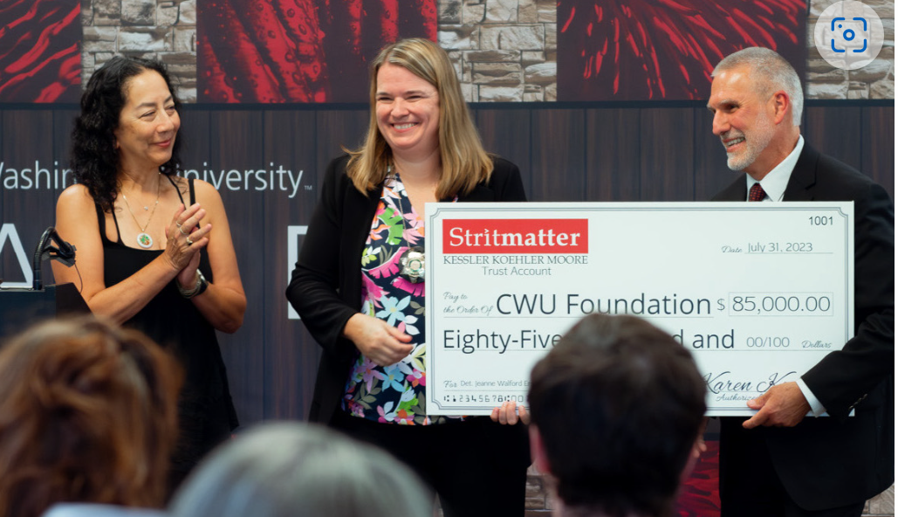
Wildcats Do Great Things
King County Sheriff's detective Jeanne Walford presents a scholarship endowment check to CWU President Jim Wohlpart at a July 31 event at CWU-Sammamish.

Slide 48
Why are we here?

Slide 49
The Bear

Slide 50
Central Washington University will be a model learning community of equity and belonging.

